Slide 1
CREATE Program: 2019 Transport Chicago June 14, 2019
Notes:
Alex

Slide 2
What is CREATE? Chicago Region Environmental and Transportation Efficiency (CREATE) Program
A $4.6 billion Public-Private Partnership (PPP) designed to improve transportation flow through Chicago
CREATE is a cooperative project involving:
US Department of Transportation (FHWA & FRA)
Illinois Department of Transportation (IDOT)
Cook County
Chicago Department of Transportation (CDOT)
6 major North American freight rail carriers and 2 switching railroads
2 passenger carriers (Amtrak & Metra)
CREATE Partners
Notes:
Alex

Slide 3
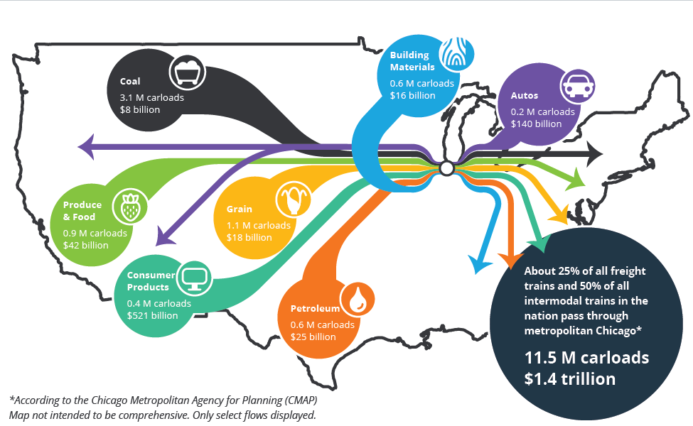
Keeping the Nation’s Economy Moving
Notes:
Alex

Slide 4
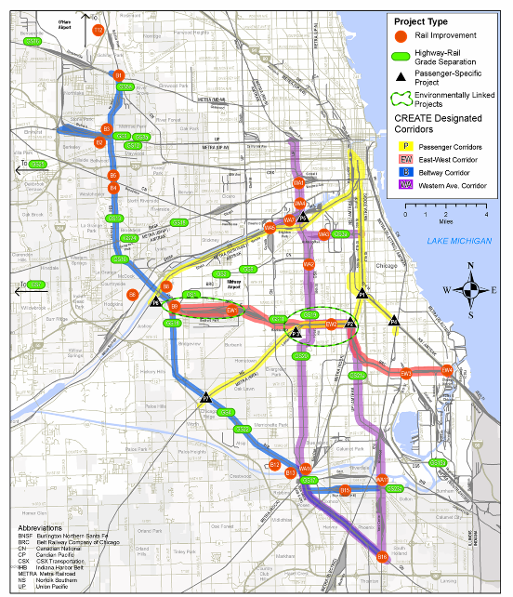
Four Corridors
Passenger Corridor
East-West Corridor
Beltway Corridor
Western Ave. Corridor
Notes:
Alex

Slide 5
Project Status
25 road/rail grade separations
6 passenger/freight rail grade separations
Railroad projects to improve rail infrastructure and upgrade technologies
Viaduct improvement program
Grade crossing safety enhancements
Rail operations and visibility improvements
Notes:
Alex

Slide 6
CREATE Program Benefits
Notes:
ALEX
Passenger train delay reduced by over 1.3 million passenger hours annually
92,000 hours of truck delay and 230,000 hours of motorist and bus passenger delay will be saved
200 vehicle crashes with trains will be avoided
2,800 metric tons/year avoided emissions from idling vehicles
Enable extra 50,000 freight trains to travel through the greater Chicago rail network annually
122 million tons of freight per year would travel by rail, avoiding 18,500 truck trips per day on highways

Slide 7
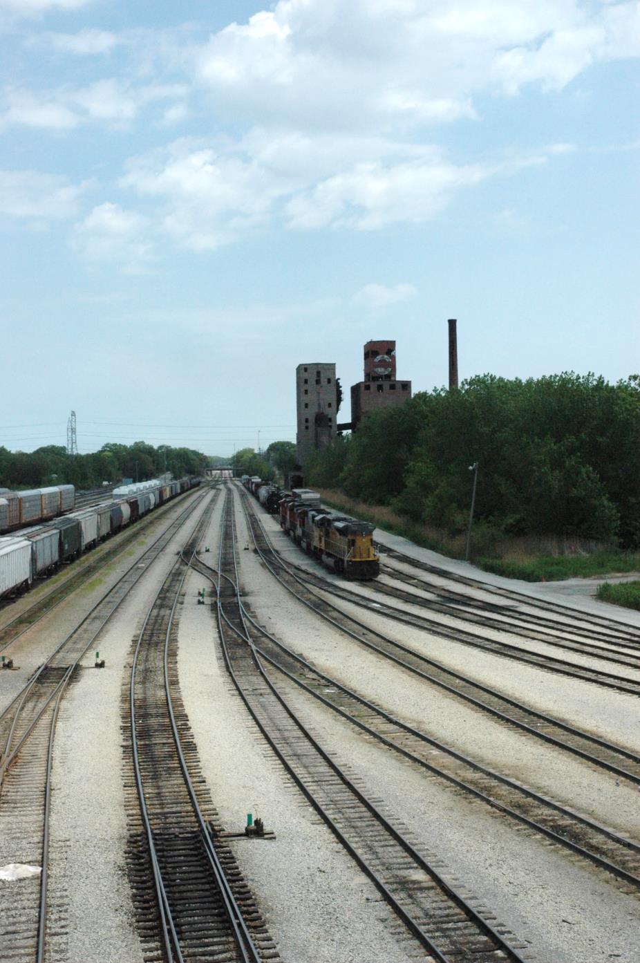
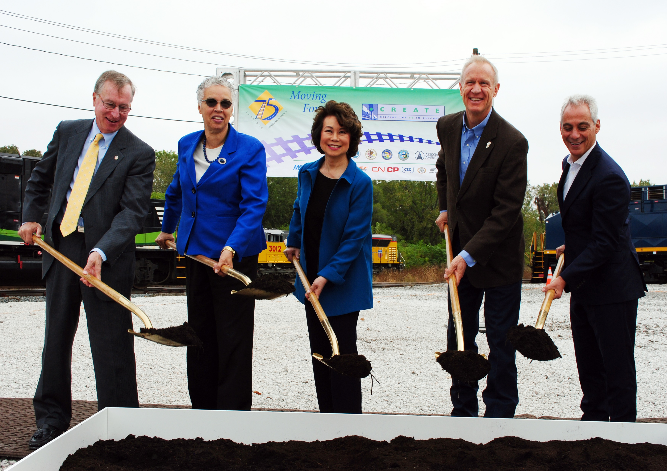
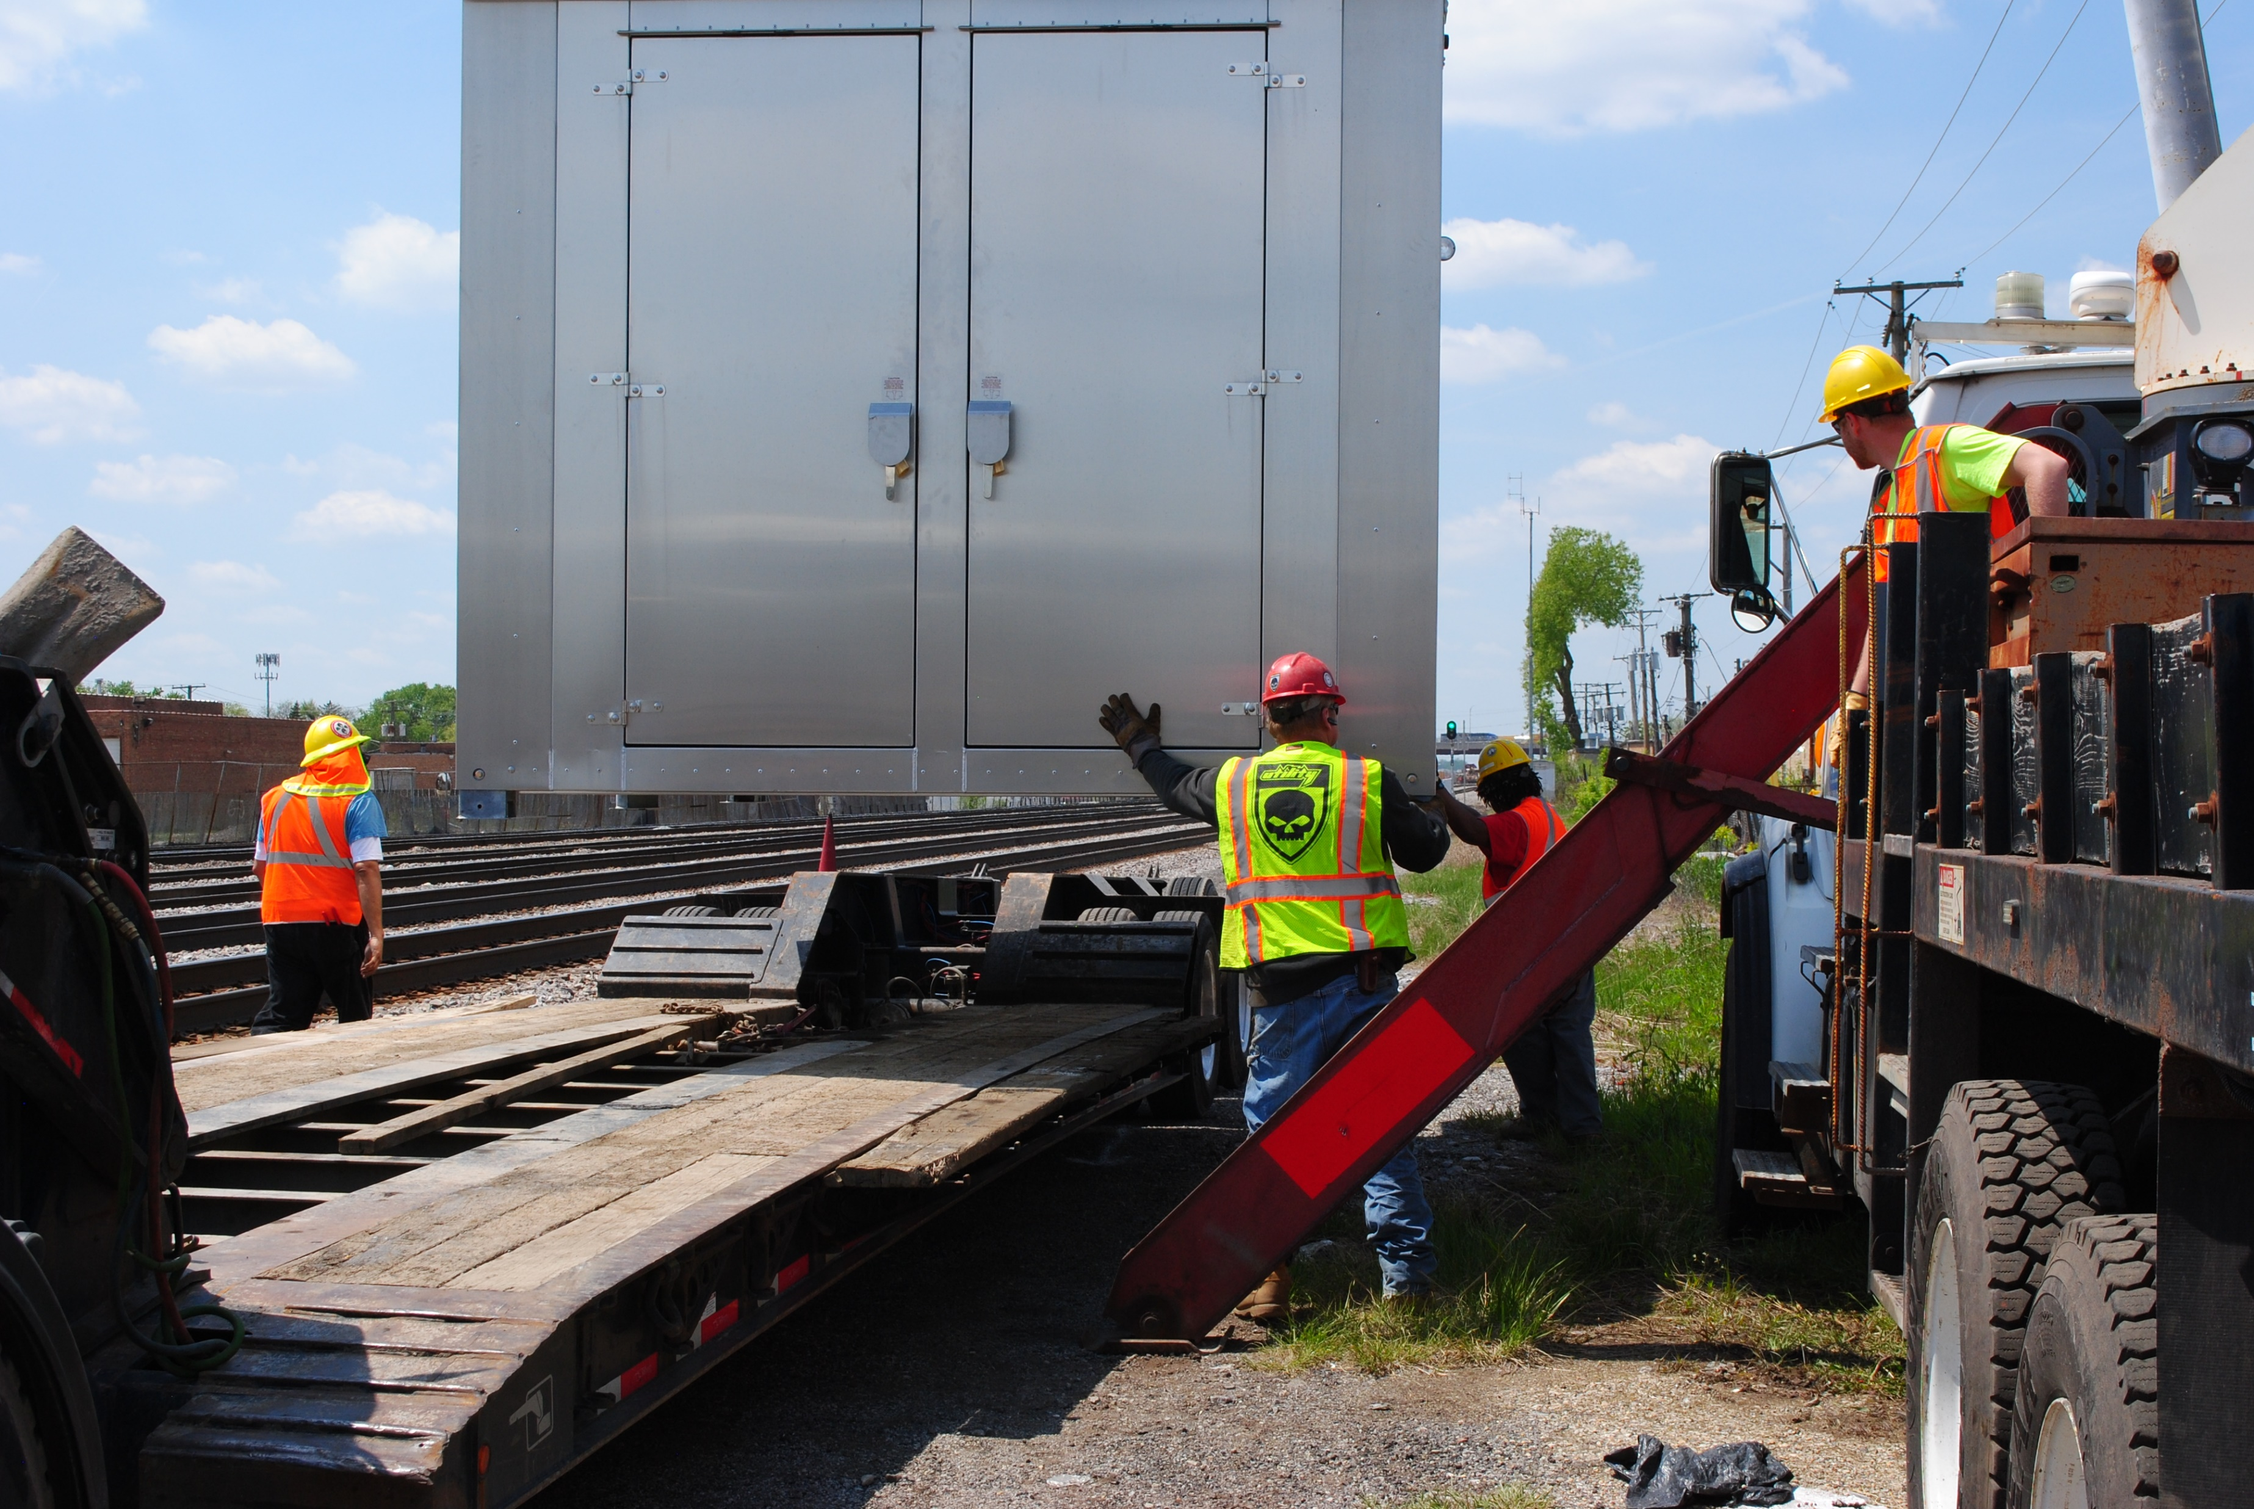
ON THE MOVE Project Delivery
Notes:
Jeff

Slide 8
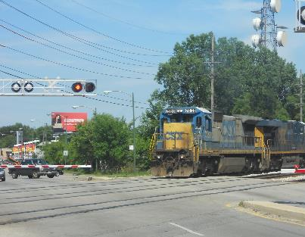
Partners Keep CREATE Moving
GRADE SEPARATION STUDIES
Archer Avenue
Phase I study
Columbus Avenue
Awarded Competitive State Freight Grant ($49 M), June 2018
Phase III construction is funded, expected timing 2022-2023
95th Street & Eggleston Avenue
Awarded FRA grant, Phase I in progress
Columbus Ave.
Notes:
Jeff - GS highlights

Slide 9
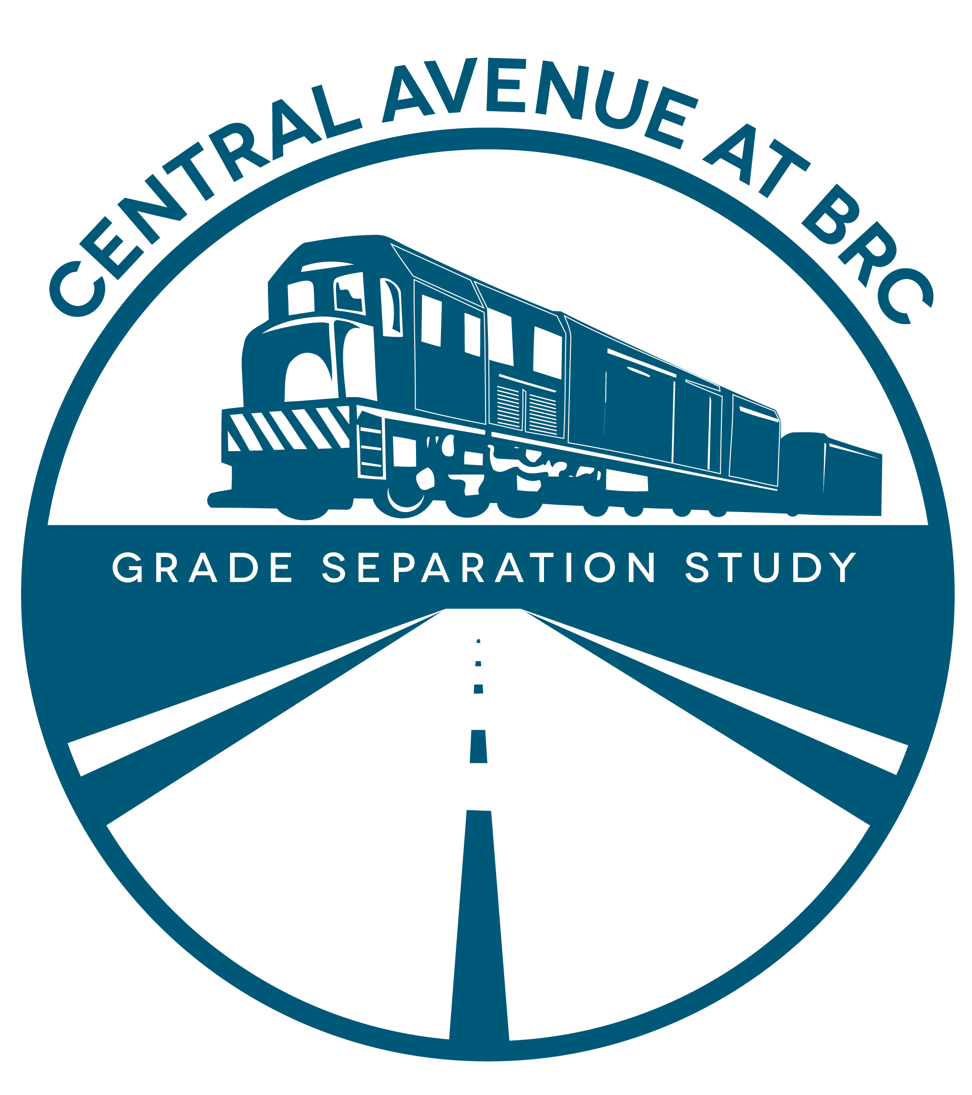
Partners Keep CREATE Moving
GRADE SEPARATION STUDIES
63rd Street/65th Street & Harlem Avenue (IL43)
Phase I in progress
54th & Central Avenue
Phase I in progress
Notes:
Sam – GS highlights

Slide 10
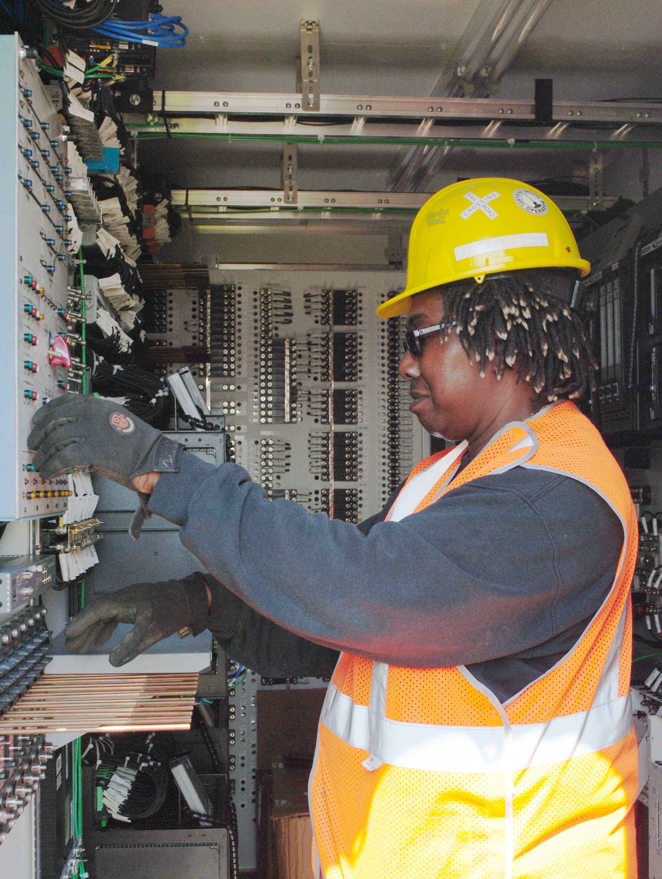
Partners Keep CREATE Moving
BNSF Connection (WA4)
Completed
Canal Flyover (P6)
Phase I documents submitted in 2019
Crossovers Upgrades (B1)
In construction
Dolton Interlocking (WA11)
CRISI Grant submitted 2018
B1 signal installation
Notes:
Bill - RR proj highlight

Slide 11
Union Pacific Third Mainline (B2)
Location: Melrose Park, IL
60 freight trains & 59 Union Pacific Metra trains affected
Results
Constructed 3.5-mile third main track on UP
Constructed railroad bridge over Addison Creek
Constructed flyover connection from the Indiana Harbor Belt (IHB) to Union Pacific (UP)
Control points reconfigured
Track between the UP and IHB upgraded
Metra’s Berkeley and Bellwood passenger stations improved; pedestrian underpasses constructed
Before
After
Notes:
Bill

Slide 12
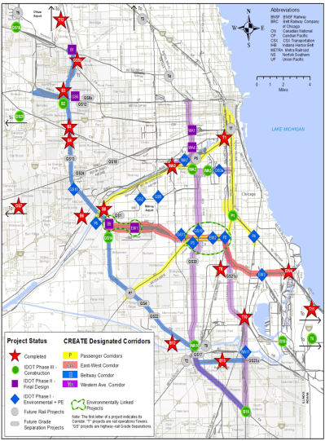
Englewood Flyover (P1)
Removed conflict point between commuter, passenger and freight trains, alleviating delay for commuters and Amtrak’s most severe delay point in the Midwest.
Completed 2014
Reduced rail/rail conflicts
Notes:
Bill

Slide 13
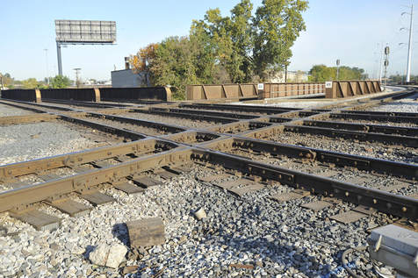
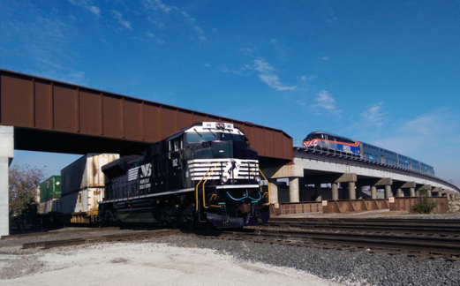
Englewood Flyover (P1)
Looking North
Before 2011
After 2014
Notes:
Bill

Slide 14
Viaduct Program
Locations in the City of Chicago
Improved roadways, sidewalks and drainage under railroad viaducts
Enhanced safety and security for motorists, pedestrians and bicyclists
37 locations completed in 2006
14 locations completed in 2012 (USDOT TIGER funding, $5 million)
11 completed in 2015/2016 (State of Illinois funding)
Notes:
Jeff

Slide 15
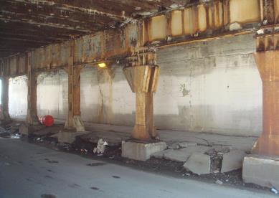
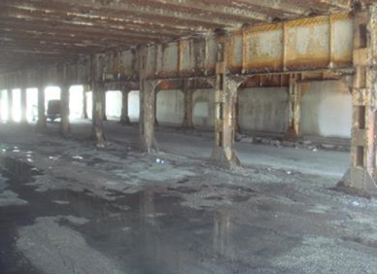
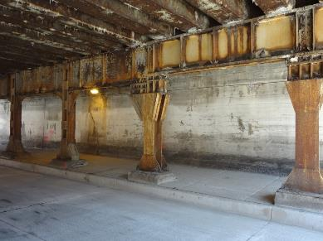
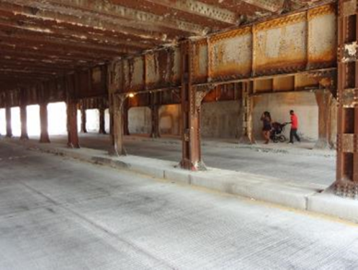
Viaduct Improvement Program
Example: 1530 S Loomis Street
Example: 1530 S Racine Avenue
Before
Before
After
After
Notes:
Jeff

Slide 16
INFRA Grant Funded Projects
Notes:
Sam

Slide 17
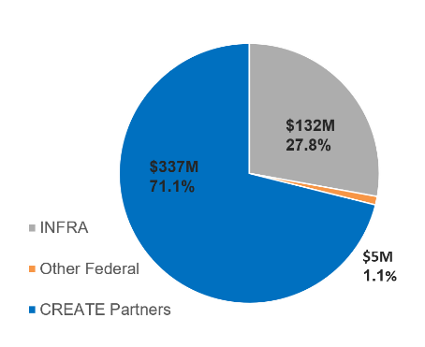
INFRA Grant Award in 2018
$474 million total funding commitment will
Complete design of the entire 75th St. CIP
Build Argo Connections (B9)
Build half of 75th St. CIP
$132 million federal INFRA funds closed the funding gap and advances the project toward completion
Due to federal funding requirements projects must meet design and construction schedules
Notes:
SAM
Note Federal timeline and implications
Funding Breakdown:
$116M – Class I RR
$132M – Federal
$5M – Amtrak
$77.75M – Cook County
$23.75M – Metra
$8.5M – CDOT
$111M – IDOT

Slide 18
INFRA Grant Funded Projects
75th Street CIP (design and partial construction)
75th Street CIP (design and partial construction)
Argo Junction (construction)
Notes:
JEFF

Slide 19
Status of INFRA Grant Funded Projects
Design complete
Contractor selected
Designer selected
Contractor TBD
Designer selected
Contractor TBD
Designer TBD
Construction not yet funded
Designer TBD
Construction not yet funded
Notes:
JEFF

Slide 20
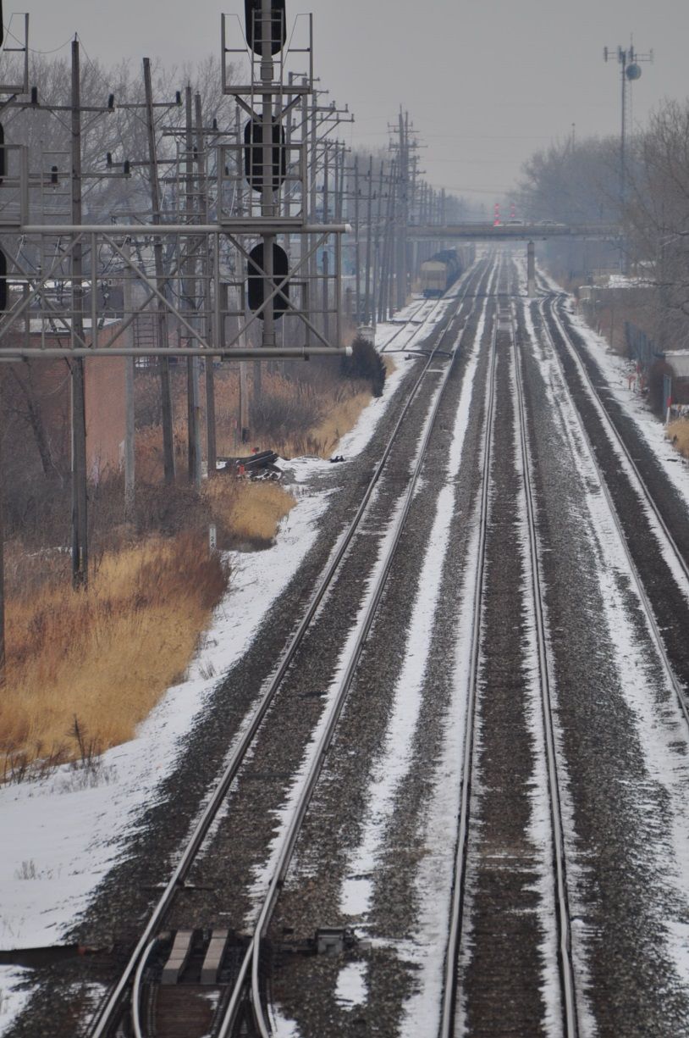
Argo Connections (B9)
Phase III Construction
Selection for Construction Management in progress
CSX responsible railroad
Notes:
SAM
Explain force account
B9 is at $36M from CSX request (still needs validation from IDOT), $34M was an old number from the grant
DBE % was assigned by Pam Simon from Central office Dec 2017
Construction observation includes CM to be procured by CSX

Slide 21
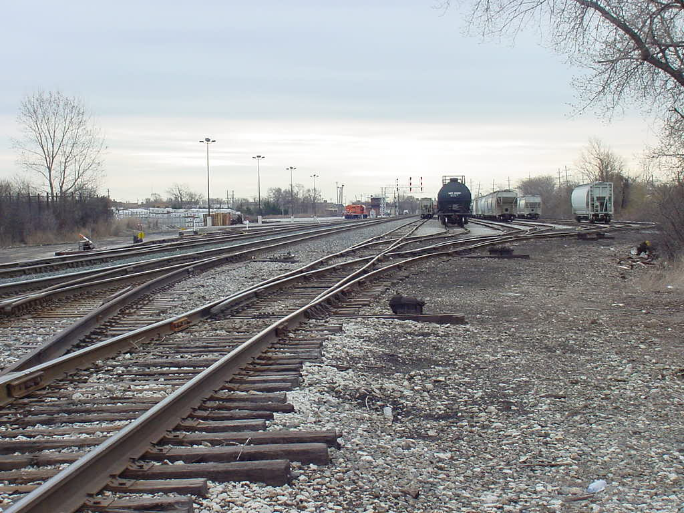
Argo Connections (B9)
Notes:
SAM

Slide 22
A Closer Look at the 75th Street Corridor
CSX
CSX
CSX
CSX
King
Kedzie
King
Pulaski
Kedzie
Pulaski
Ashland
Western
Ashland
Western
Damen
Damen
Racine
Racine
Halsted
Halsted
NS
NS
Michigan
California
Michigan
California
Metra RID
NS & Metra
Metra RID
NS & Metra
67th
Trains delayed
Trains idle on tracks while waiting
71st St Grade Crossing
67th
I-90
I-90
Vincennes
Vincennes
71st
71st
BRC
BRC
I-94
I-94
75th
75th
Forest Hill
Junction
Belt Junction
80th St Junction
79th
79th
83rd
83rd
Metra SWS & NS
Metra SWS & NS
Columbus
Columbus
87th
87th
BRC
Railroad Operations
CSX
BRC
NS
UP
Metra
Amtrak
BRC
& NS
Existing Conditions
& NS
95th
95th
Metra RID
Metra RID
Metra RID
Metra RID
I-57
I-57
UPRR
CSX
UPRR
CSX
I-94
CSX
I-94
CSX
Notes:
Jeff

Slide 23
A Closer Look at the 75th Street Corridor
Pulaski
CSX
Kedzie
CSX
Ashland
King
Western
Damen
Racine
Halsted
NS
California
NS & Metra
Metra RID
Michigan
67th
Fluid train movement
Trains pass through without idling
GS19
71st St Grade Separation
I-90
Vincennes
71st
BRC
I-94
75th
P3
Forest Hill Flyover
P2
Rock Island Connector
(untangles Belt Junction)
79th
EW2
80th St Junction Reconfiguration
83rd
Metra SWS & NS
Columbus
87th
Railroad Operations
CSX
BRC
NS
UP
Metra
Amtrak
BRC
Proposed Conditions
& NS
95th
Metra RID
Metra RID
CSX
CSX
I-57
UPRR
I-94
Notes:
Jeff

Slide 24
What will the current funding do?
Pulaski
CSX
Kedzie
CSX
Ashland
King
Western
Damen
Racine
Halsted
NS
California
NS & Metra
Metra RID
Michigan
67th
Design
Construction
GS19
71st St Grade Separation
I-90
Vincennes
71st
BRC
I-94
GS19
75th
P3
Forest Hill Flyover
P2
Rock Island Connector
(untangles Belt Junction)
79th
P3
EW2
80th St Junction Reconfiguration
83rd
P2
Metra SWS & NS
Columbus
87th
EW2
Railroad Operations
CSX
BRC
NS
UP
Metra
Amtrak
BRC
& NS
The CREATE Partners will seek future funding to finish construction of P2 and EW2.
95th
Metra RID
Metra RID
CSX
CSX
I-57
UPRR
I-94
Notes:
Jeff

Slide 25
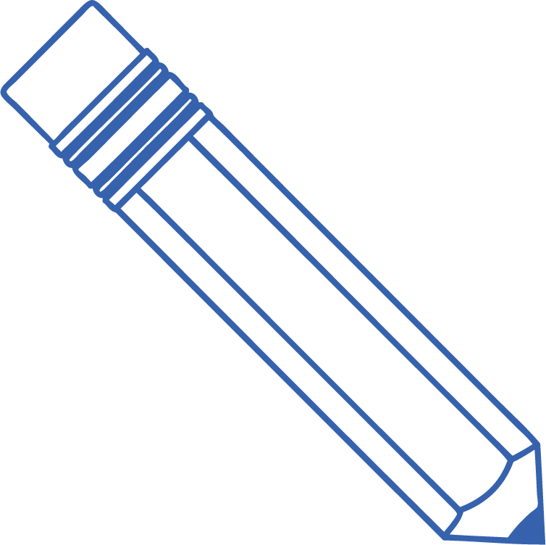
P3 - Forest Hill Flyover
Construct bridge to carry north-south CSX tracks over east-west tracks at 75th Street and over roadway at 71st Street
Bridge extends from 68th Street to 79th Street
Existing Conditions, facing east
Concept Rendering, facing east
Notes:
Jeff

Slide 26
P3 - Forest Hill Flyover
New CSX Railroad Bridge over Metra, BRC & NS – 7500S to 7900S
Approx. 130 ft.
Property Line
Existing Cross-Section, facing north
Approx. 110 ft.
Property Line
Approx. 40 ft.
Max 30 ft.
Temporary CSX Tracks
(while bridge is being built)
Conceptual Cross-Section, facing north
Notes:
Jeff

Slide 27
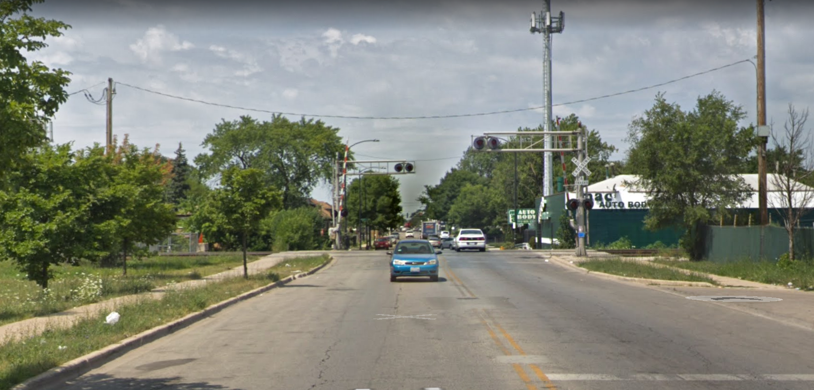
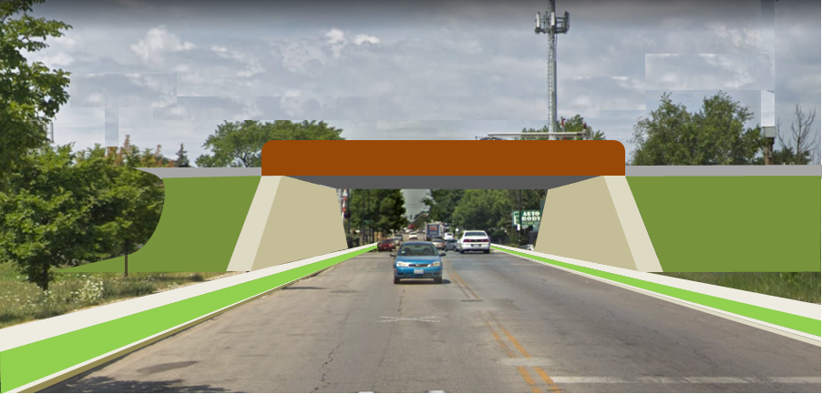
GS19 - 71st St. Grade Separation
Separates 71st Street and the north-south CSX tracks
Between Hamilton Avenue and Bell Avenue, north of Forest Hill Junction
Existing Conditions, facing west
Concept Rendering, facing west
Notes:
Jeff

Slide 28
Status of Forest Hill Junction (P3) & 71st St. Grade Separation (GS19)
Phase II Design – Parsons Team Selected
CSX Responsible Railroad
DBE % Assigned: 30%
IDOT Notice to Advertise: January 2019
Solicit RFP: February 2019
Selection: April 2019
Design Start: Summer 2019*
Design Completion: Spring 2021*
Design scope: Project management, structure and civil design, track design and railway signal design
*Anticipated timing
Notes:
Sam

Slide 29
Status of Forest Hill Junction (P3) & 71st St. Grade Separation (GS19)
Phase III Construction – Contractor TBD
CSX Responsible Railroad
DBE % Assigned: TBD
Construction sequence: Subject to change
Temporary civil and track construction (shoofly)
Permanent structure, grade separation, track and signal construction
IDOT Notice to Advertise (temporary construction): Spring 2020*
Solicit Bids (temporary construction): Spring 2020*
Bid and award: Summer 2020* (temporary construction)
Temporary Construction: Summer 2020 – Summer 2021*
IDOT Notice to Advertise (Permanent): Summer 2021
Permanent construction: Winter 2022 - Fall 2024*
*Anticipated timing
Notes:
SAM

Slide 30
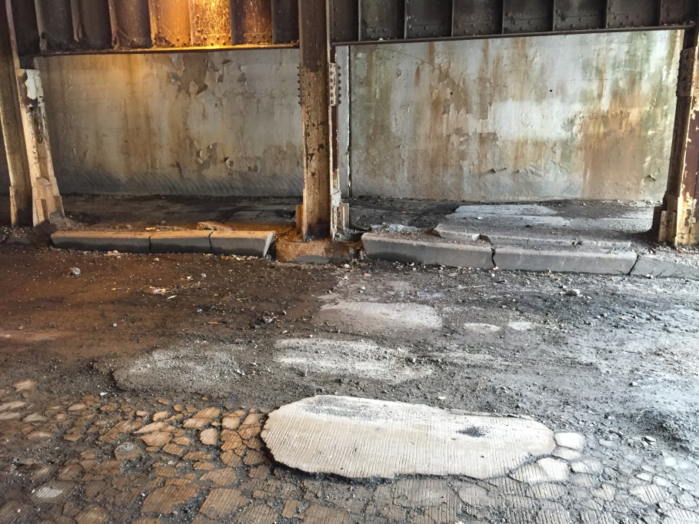
Viaduct Improvements
in the P3-GS19 project area
Reconstruction of streets and sidewalks under existing structures
Replacement of viaduct lighting
Similar improvements made in the area during 2012 and 2015
Example of viaduct improvement completed by CDOT during 2015: 600-700 W. 80th Street
Street & sidewalk after 2015 CDOT improvements
Street & sidewalk
before 2015 CDOT improvements
Notes:
Jeff

Slide 31
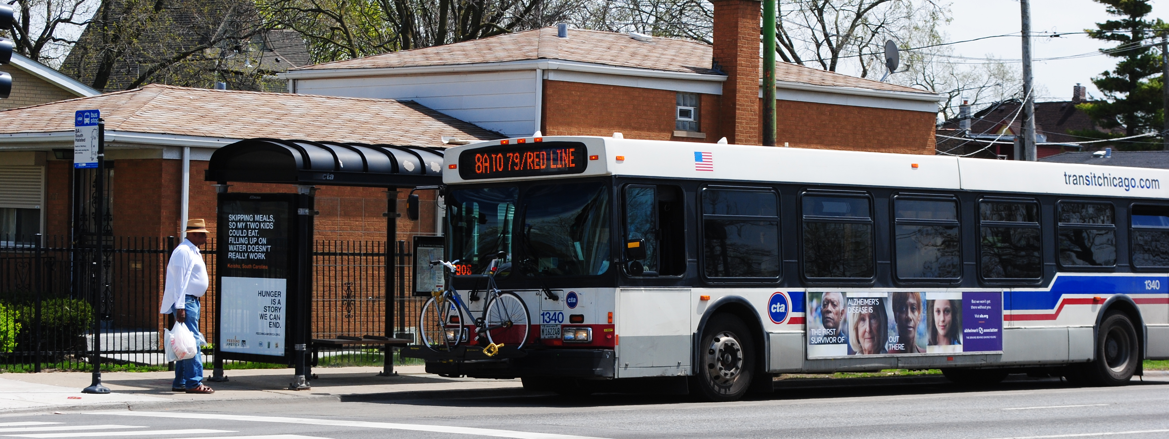
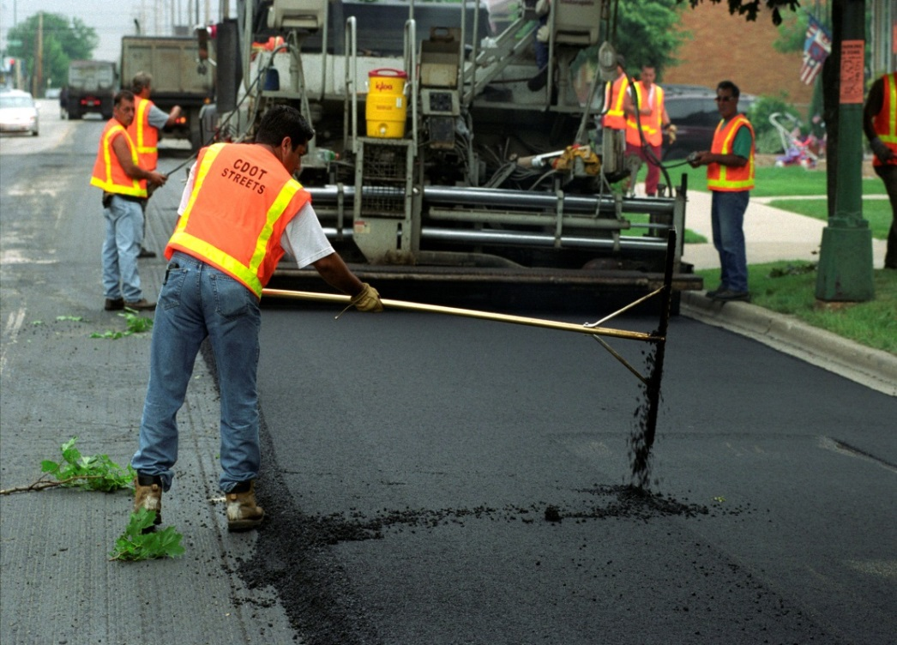
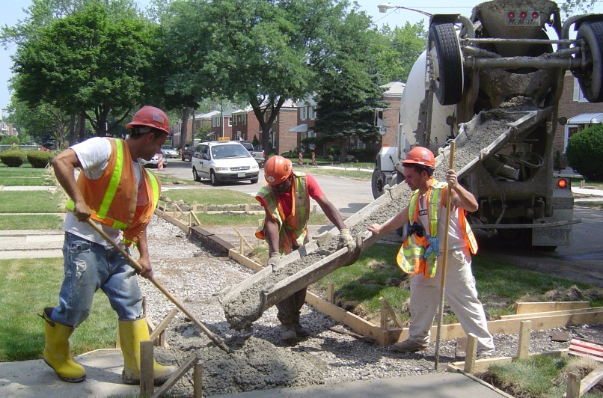
Community Mobility Improvements
Sidewalk improvements
Street improvements
Bus stop improvements
New street trees
Bicycle facilities
Notes:
Jeff

Slide 32
Status of Viaduct and Community Mobility Improvements
Design & Construction
IDOT/CDOT Responsible Agencies
DBE % Assigned: Varies by project; most of these types of improvements will be built to spec (i.e., new sidewalks, drainage, paving, lighting, trees, etc.)
CDOT Notice to Advertise: Winter 2020*
Solicit Bids: Spring 2020*
Construction start: 2020 – 2021*
Construction completion: 2021 – 2022*
Bid scope: Varies by project (i.e., new sidewalks, drainage, paving, lighting, trees, etc.)
*Anticipated timing
Notes:
JEFf

Slide 33
What will the current funding do?
Pulaski
CSX
Kedzie
CSX
Ashland
King
Western
Damen
Racine
Halsted
NS
California
NS & Metra
Metra RID
Michigan
67th
Design
Construction
GS19
71st St Grade Separation
I-90
Vincennes
71st
BRC
I-94
GS19
75th
P3
Forest Hill Flyover
P2
Rock Island Connector
(untangles Belt Junction)
79th
P3
EW2
80th St Junction Reconfiguration
83rd
P2
Metra SWS & NS
Columbus
87th
EW2
Railroad Operations
CSX
BRC
NS
UP
Metra
Amtrak
BRC
& NS
The CREATE Partners will seek future funding to finish construction of P2 and EW2.
95th
Metra RID
Metra RID
CSX
CSX
I-57
UPRR
I-94
Notes:
JEFF

Slide 34
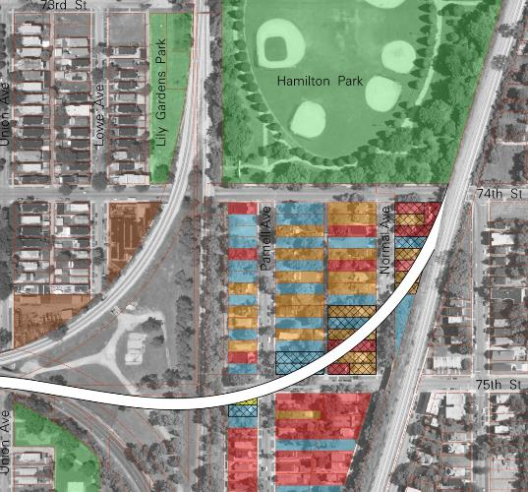
P2 - Rock Island Connector
New Metra flyover structure south of Hamilton Park
Proposed path of structure and land use map from 2014 Environmental Impact Statement report
Notes:
JEFF

Slide 35
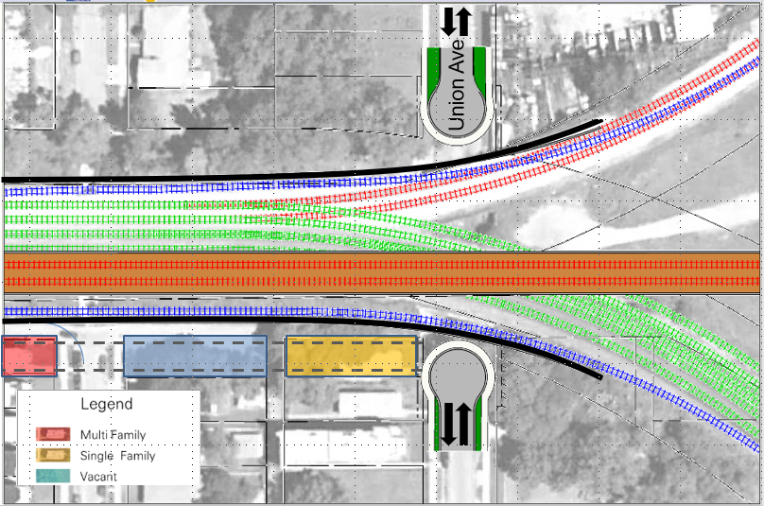
P2 - Rock Island Connector
Union Avenue underpass to be removed & embankment widened to south
Emerald Ave
Freight railroad tracks realigned on existing embankment
Proposed Metra tracks on new structure above
Notes:
JEFF

Slide 36
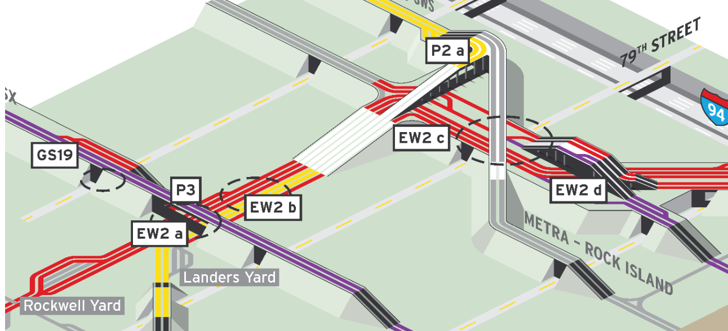
Status of Rock Island Connector (P2)
Phase II Design
Metra Responsible Railroad
Hire Design consultant: Summer 2019*
DBE % will be assigned
IDOT involved with selection process
PS&E submittal: Summer 2021*
State Rail Agreements
Funding for construction needed
*Anticipated timing
Notes:
SAM

Slide 37
EW2 – Belt Jct. & 80th St. Jct. Reconfiguration
Track realignment and reconstruction of existing railroad structures
EW2
80th St Junction Reconfiguration
Project Area
Notes:
BILL

Slide 38
Status of Belt Jct. & 80th St. Jct. Reconfiguration (EW2)
Phase II Design
Belt Junction & 80th Street Junction (EW2)
Norfolk Southern Responsible Railroad
Hire lead consultant: Summer 2019
Hire design consultant: Fall 2019*
DBE % will be assigned
IDOT involved with selection process
PS&E submittal: Summer 2021*
State Rail Agreements
Villa Grove Subdivision (EW2)
Union Pacific Responsible Railroad
Hire Design Consultant: Summer 2019*
DBE % will be assigned
IDOT involved with selection process
PS&E submittal: Summer 2021*
State Rail Agreements
*Anticipated timing
Notes:
BILL

Slide 39
Timeline
Notes:
BILL

Slide 40
CREATE Bid Advertisements/RFPs
Sign-up at createprogram.org/business.htm
Receive each partner’s CREATE Bid Advertisements
Notes:
SAM

Slide 41
Thank You! Questions?
E-mail: info@createprogram.org
Procurement Sign Up: www.createprogram.org/business.htm
“Like” Us on Facebook at:
Facebook.com/CREATEProgramChicago
Notes:
SAM

