Slide 1
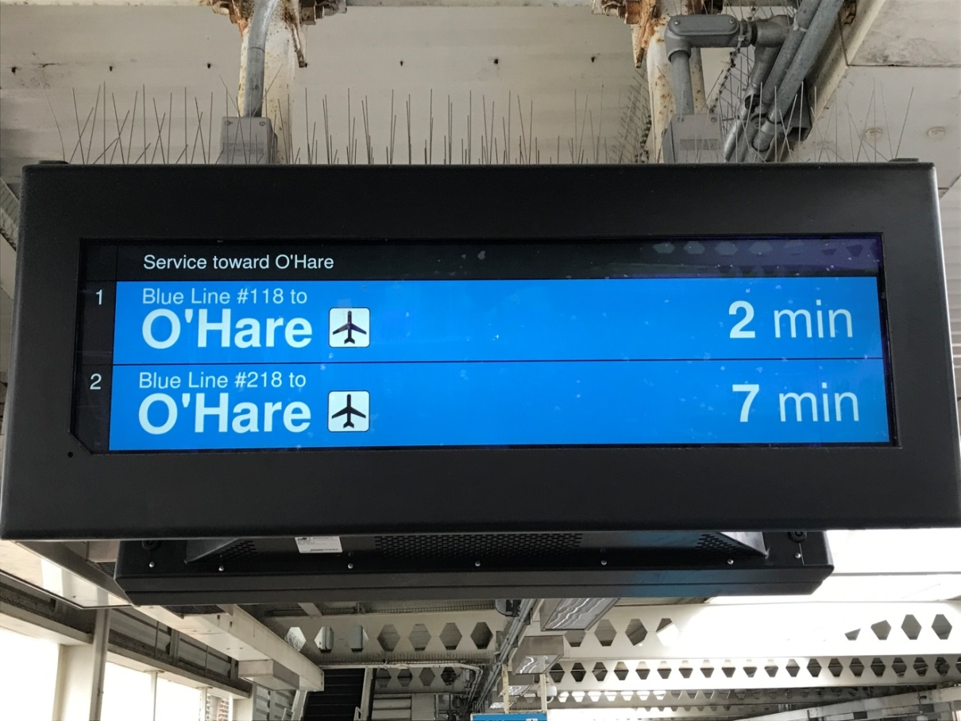
Running Time Analysis for
Better Service and a Balanced Budget
Lok Kwan
CTA Rail Scheduling lkwan@transitchicago.com

Slide 2
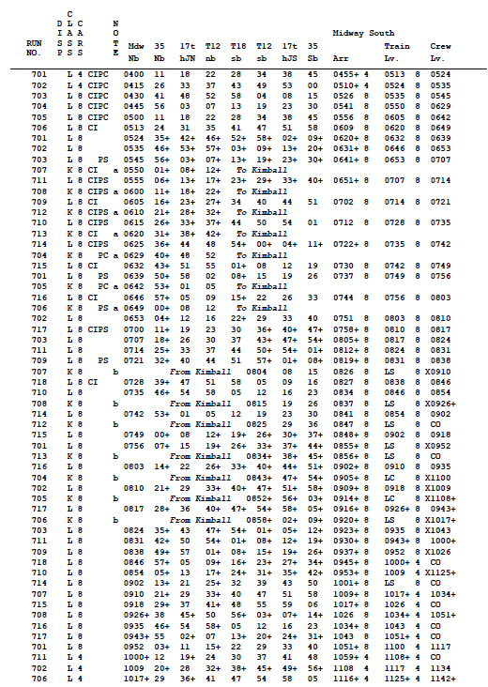
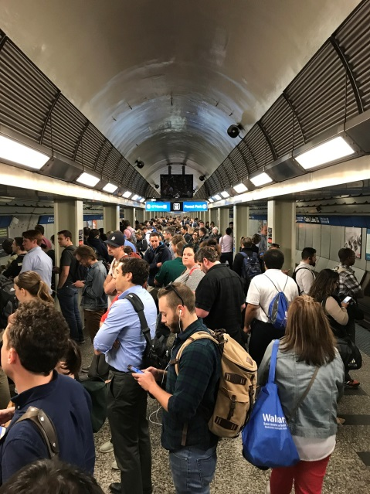
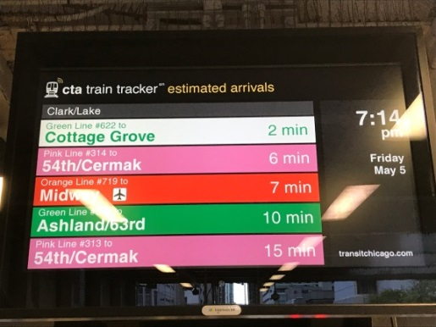
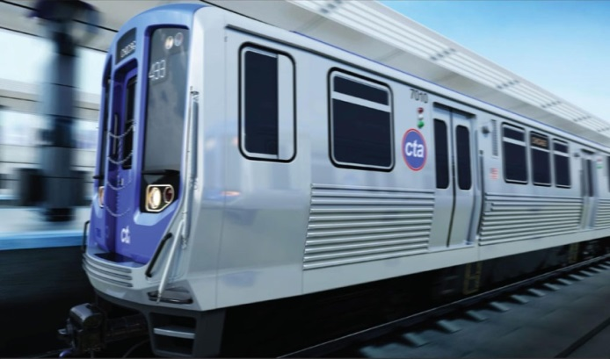
Impacts of Schedule Running Time
$
Budget

Slide 3
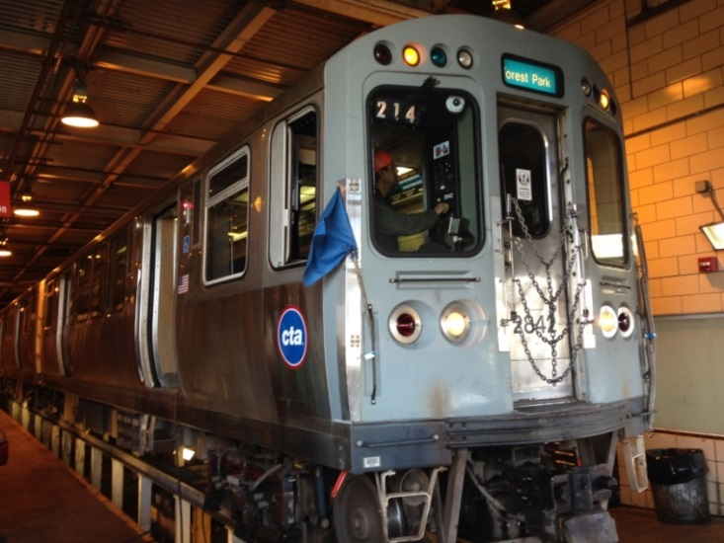
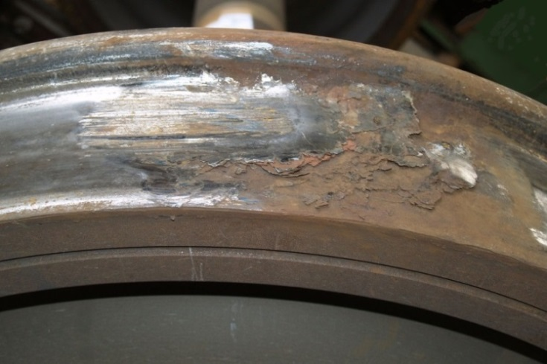
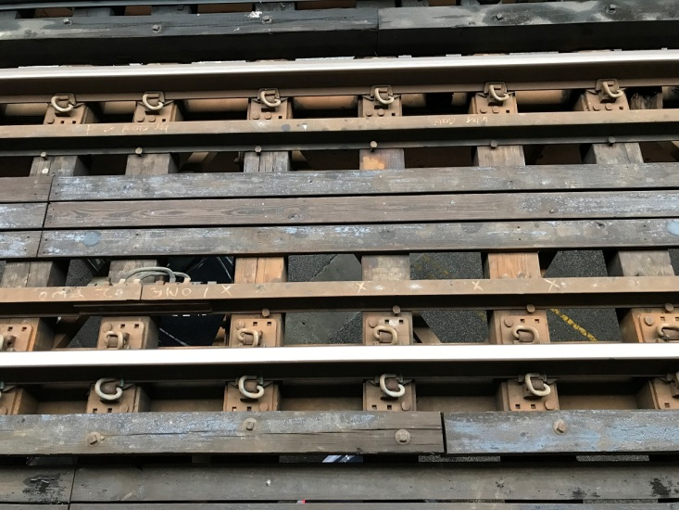
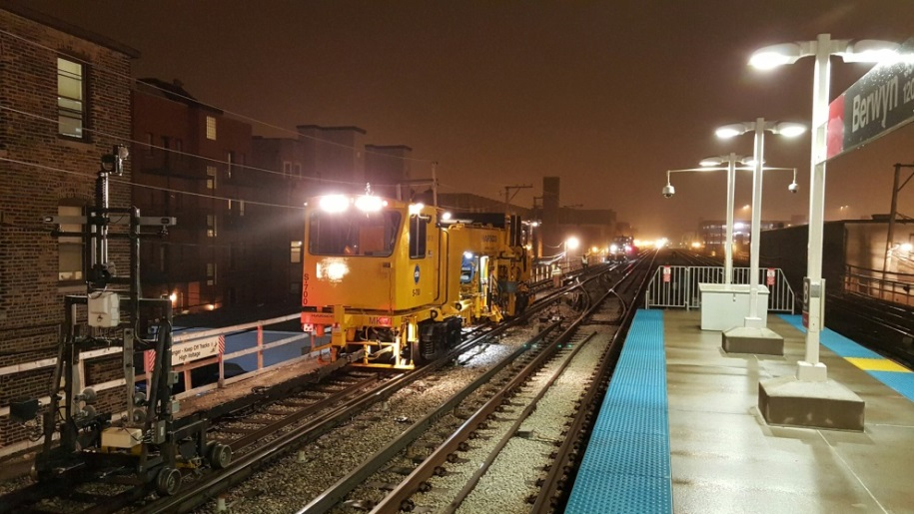
Budget and Efficiency
Inspection and Maintenance Cost
Revenue hour is one of the basic elements for forming an operating budget in the transit industry.
*Train Wheel Flat Spot photo by Wikipedia

Slide 4
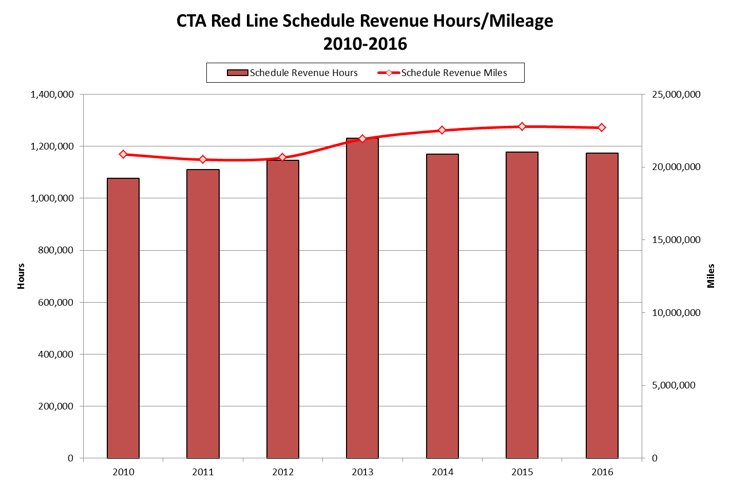
Budget and Efficiency
4 minutes travel time reduction (One direction) from the Dan Ryan project.
Running time reduction from the Dan Ryan Reconstruction have achieved revenue hour savings despite revenue mileage (service) had gone up.

Slide 5
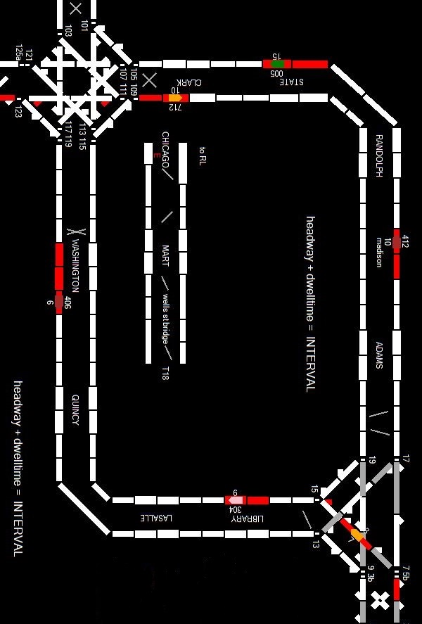
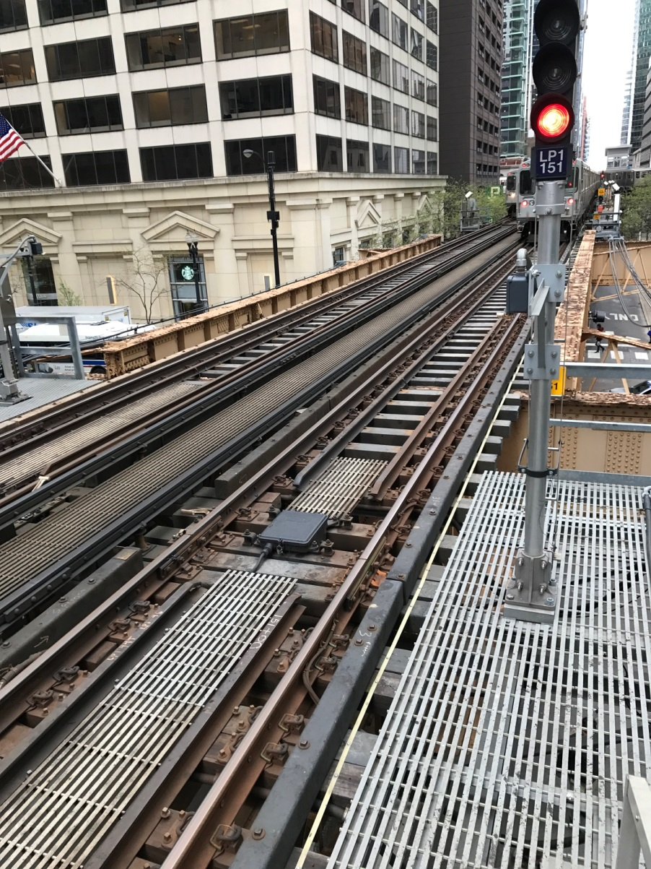
Data Collection
Supervisory control and data acquisition (SCADA)
Quictrak

Slide 6
Methodology
Track Occupancy Data
Signal & Interlocking
Running Time
Mileage
Dwell Time
Headway/Interval
Data Transformation Model
  Eliminate garbage data (Example: faulty track circuit)
  Format timestamp and datatype
  “Line-up” data rows (Oracle Analytical Functions: Lead/Lag)
  Relate tables to organize train data by route, direction, and sequence

Slide 7
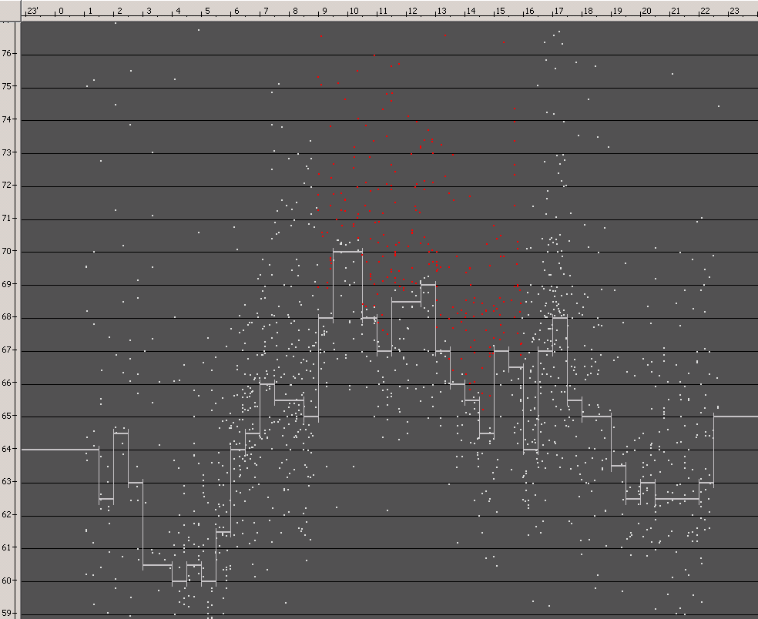
Running Time Analysis
GIRO Hastus ATP Tool (From French: Analyse des Temps de Parcours)
CTA Red Line NB (95th to Howard)
Running Time
Time

Slide 8
Orange Line: Midway to 35th/Archer
Length: Approx. 28,748 Linear Trk ft

Slide 9
Orange Line: Midway to 35th/Archer
Increased Runtime?
AM Peak
(0600-0900)
7 Org-Brn trains
Ridership
Dwell Time
AM Peak
Late Shoulder
(0900-1230)
Construction
Track Inspection
Signal Maintenance
Lunch Break at noon

Slide 10
Orange Line: 17th Junction to Tower 12
Tower 12
Length: Approx. 6,994 Linear Trk ft
17th Junction

Slide 11
Orange Line: 17th Junction to Tower 12
The Orange Line and the Green Line share the same tracks from 17th Junction to Tower 12. Interestingly, the Orange Line requires more travel time than the Green Line.

Slide 12
Orange Line Vs Green Line
At Tower 12, the NB Orange Line has five “conflicting moves” whereas the NB Green Line will only conflict with the Brown Line. The Orange Line also requires a cross-over move while the Green Line will simply get a straight line-up.

Slide 13
Orange Line Vs Green Line
Compared to the Green Line, Junction travel time data clearly indicated the Orange Line requires more travel time to enter and clear at Tower 12.

Slide 14
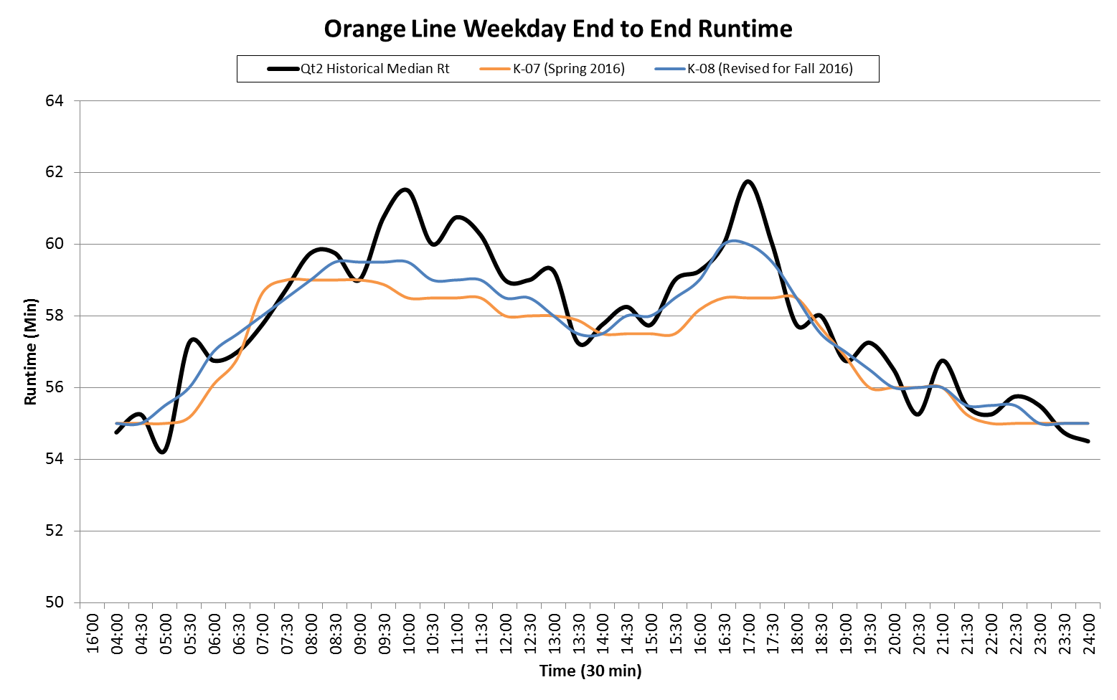
Orange Line – Total Runtime
(Midway to Midway)
CTA rail running time has high “variability” during the late AM peak shoulder due to personnel on the Right-of-way and terminal congestion from yard moves.
PM peak of the peak running time is generally the greatest due to excessive dwell time and loop congestion.

Slide 15
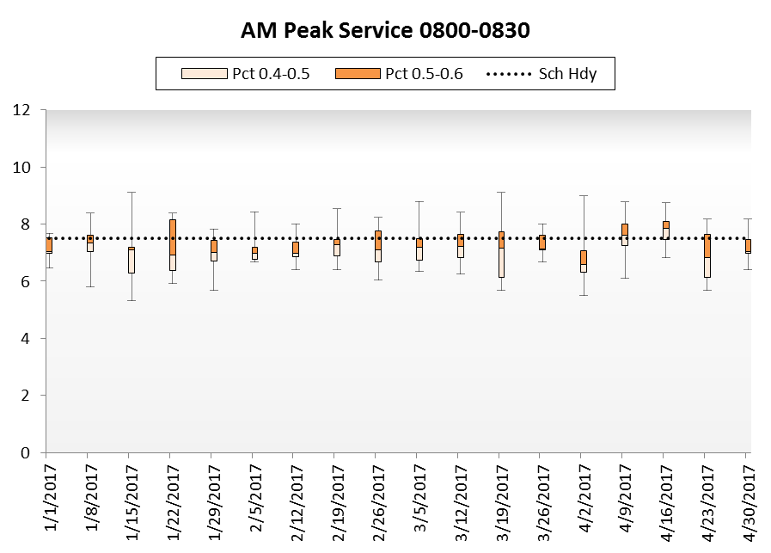
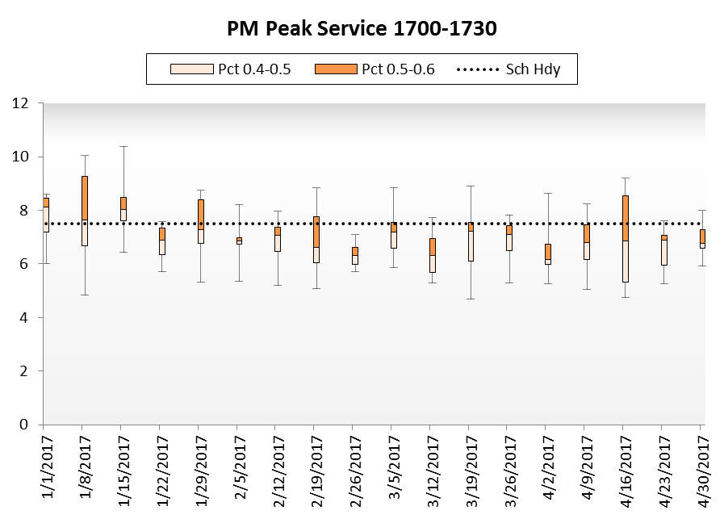
Orange Line – Roosevelt Station
AM Peak Service Vs PM Peak Service
Orange Line PM peak service is less reliable than AM peak provided that PM headway distribution fluctuate more than the AM distribution.
    Excessive concentration of ridership at 1700
    Excessive PM Peak dwell time
    Loop Congestion
    Direction of flow (AM Inbound, PM Outbound)

Slide 16
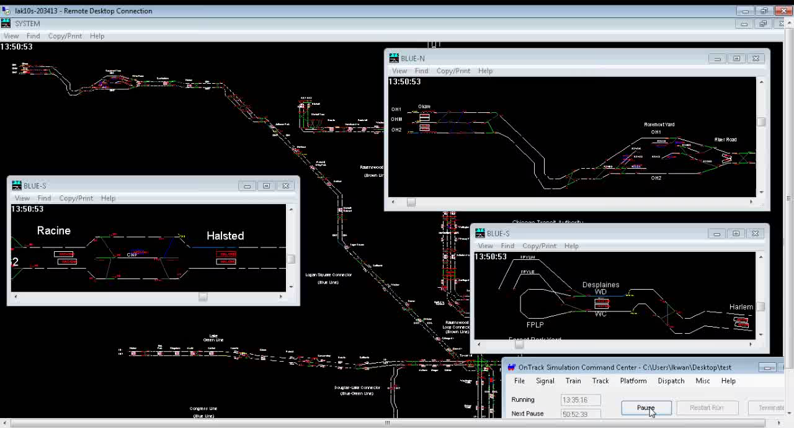
Simulation
So far all the analysis is base on historical data. What about potential or anticipated changes in the future?
What if we completely eliminate all the slow zones on the Blue Line Congress branch?

Slide 17
Simulation
Blue Line Congress Branch (NB)
In this Speed & Distance graph, the Yellow Line represents the speed of a simulated train operating on the Congress branch without any Slow Zone. The Blue Line represents the speed of a simulated train operating on the current Congress Branch with 30,233 ft of Slow Zones.

Slide 18
Simulation
Blue Line Congress Branch (SB)
The simulated train under the “Slow Zone free” Congress branch achieved much faster operating speeds when compared to the simulated train under the current Congress branch with 30,233 ft of Slow Zones.

Slide 19
Simulation
Blue Line Congress Branch
Blue Line Congress Branch NB: 0:02:53 travel time savings
Blue Line Congress Branch SB: 0:04:15 travel time savings
Greatest travel time reduction between Western SB – Kedzie SB and Cicero SB – Austin SB
A robust data model and simulation allow CTA to evaluate different scenarios to prioritize track work and capital investments.

Slide 20
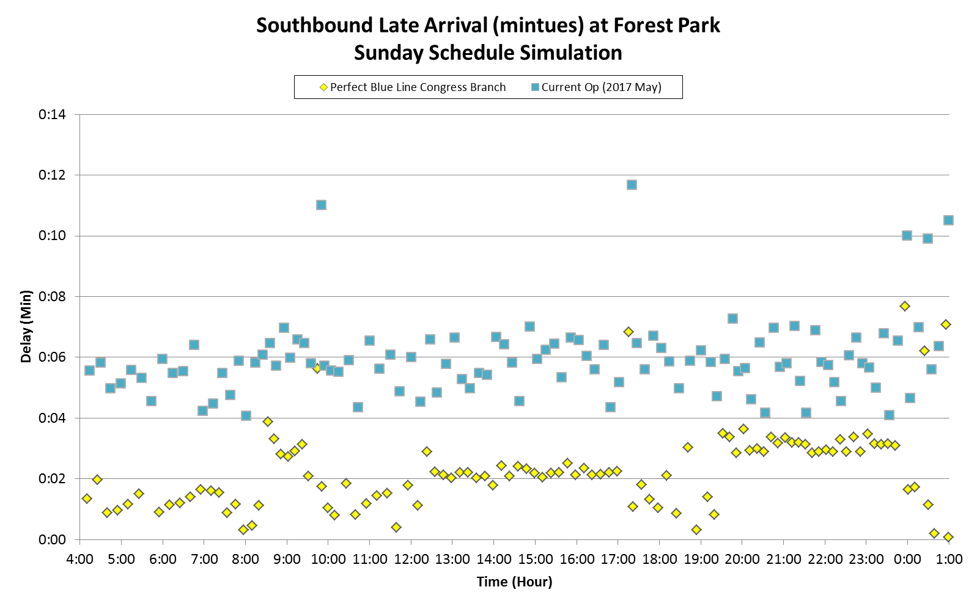
Simulation
Blue Line Forest Park Terminal
The blue dots represent Southbound terminal delays under current track condition and the yellow dots illustrate terminal delays if the Congress branch is Slow Zone free. Forest Park terminal will be more resilient to random delays if we eliminate all the Slow Zones on the Blue Line Congress branch.

Slide 21
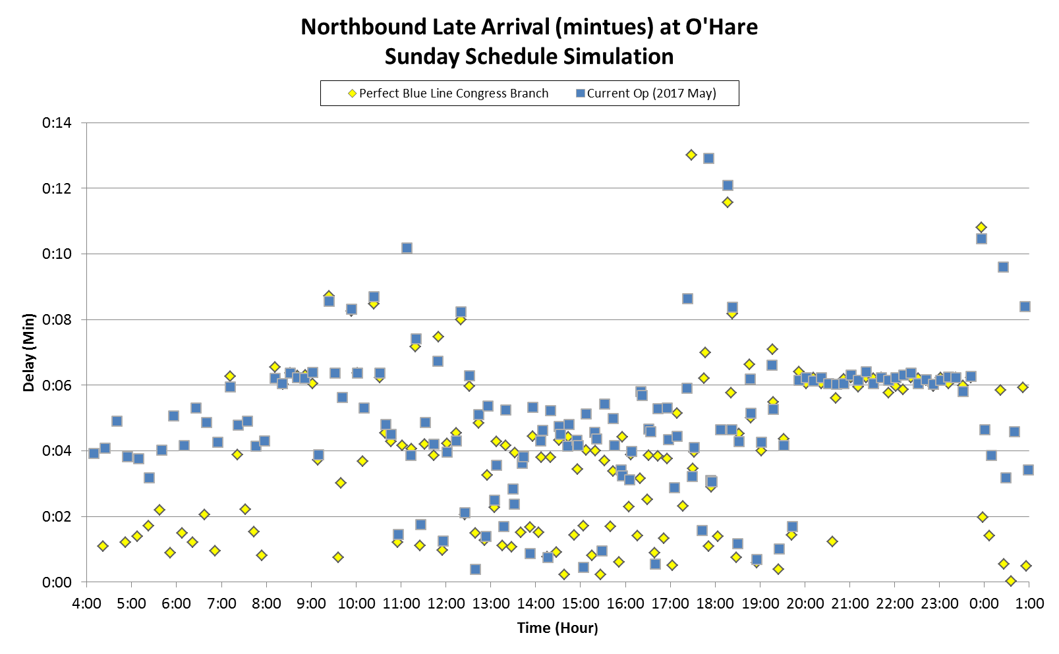
Simulation
Blue Line O’Hare Terminal
O’Hare terminal achieved less significant improvements due to less Northbound travel time reduction.

Slide 22
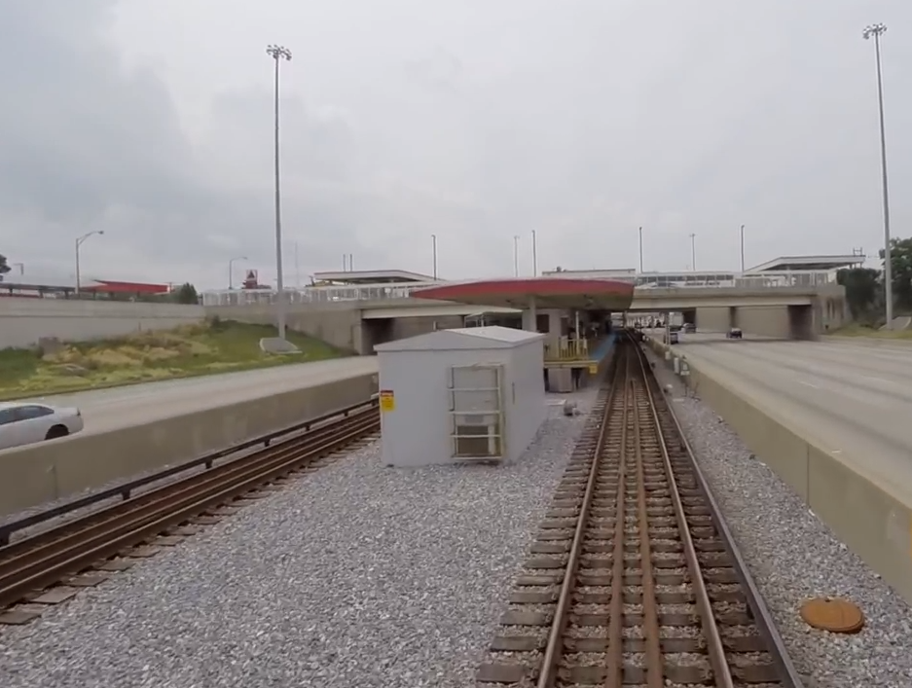

Optional Discussion - Terminal Congestion
Red Line 95th Terminal
Southbound Trains
Interlocking
Northbound Trains
Platform
West Pocket
East
Pocket
Red Line 95th Station is known for having terminal congestion between 0900 and 1000 because of an imbalanced inbound and outbound headway. Given that 95th Station has two pockets for stub operation, the theoretical maximum train recovery time would be five minutes and thirty seconds with a three minutes headway. These limitations and random delays pose significant challenges for train crews to move trains in and out of 95th terminal.

Slide 23
Optional Discussion - Terminal Congestion
Red Line 95th Terminal
Crews removing 14 in-service trains after AM peak causing runtime variability.
14 scheduled lay-ups

Slide 24
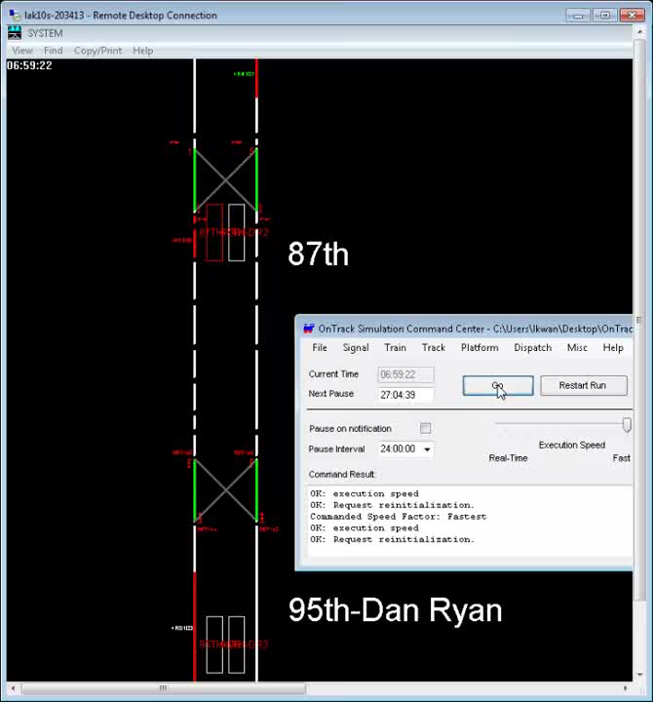
Optional Discussion - Terminal Congestion
Red Line 95th Terminal Simulation
CTA Train crews must perform the following to lay-up trains:
Prepares cars for storage
Check all cars of trains to ensure no customers remain on board
Close doors and windows
Secures all Safety chains and springs
Trims Motorcabs
Turn off interior/exterior lights
Leaves A/C turned on
Secures trains against rolling
In this situation, adding more schedule running time would not mitigate terminal congestion but worsen the problem by inserting more trains to the terminal.
Potential Solution #1
Utilize Service Restoration technique(s). Example: Gapping – When a train has been delayed approaching a terminal, a supervisor or another certified employee can operate a train to a predetermined station to “trade” train with the delayed operator.
Potential Solution #2
Space out the layups by adjusting the inbound and outbound headway
Potential Solution #3
Infrastructure improvement

Slide 25
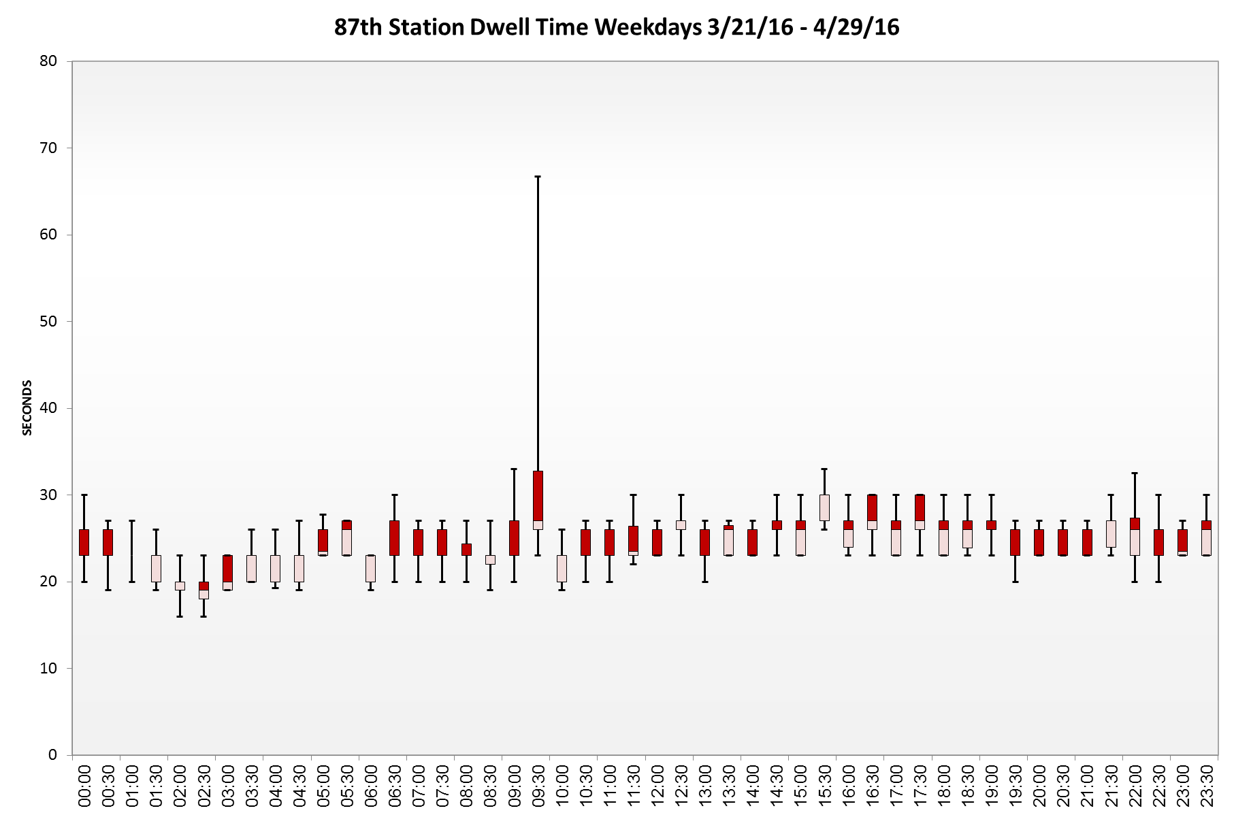
Optional Discussion - Terminal Congestion
Excessive dwell time at 87th Station:
SB trains waiting for an open pocket at 95th terminal

Slide 26
Summary
Running time is central to the formation of service and operating budget in the transit industry.
Running time analysis is the combination of arts and science base on data analysis, operation knowledge, and scheduling concepts.
A robust data model can collect and summarize service performance, running time, dwell time, vehicle mileage, and junction performance. These data is useful in monitoring service quality and operation cost.
Simulation is an important tool to quantify what-if-scenarios for providing recommendations in corrective procedures and capital investments.

Slide 27
Appendix I
Scheduling Basics
$\frac{Running Time + Recovery Time}{Headway}$ = Number of Vehicles/Train Cars
*Formula by TCRP report 30
Running time is critical to the formation of service and operating budget in the transit industry. Insufficient running time might lead to the underestimation of vehicle requirement, causing headway irregularity and unreliable service. Too much running time will lead to the overestimation of fleet size and crew requirement, resulting train bunching and an inefficient operating budget.

Slide 28
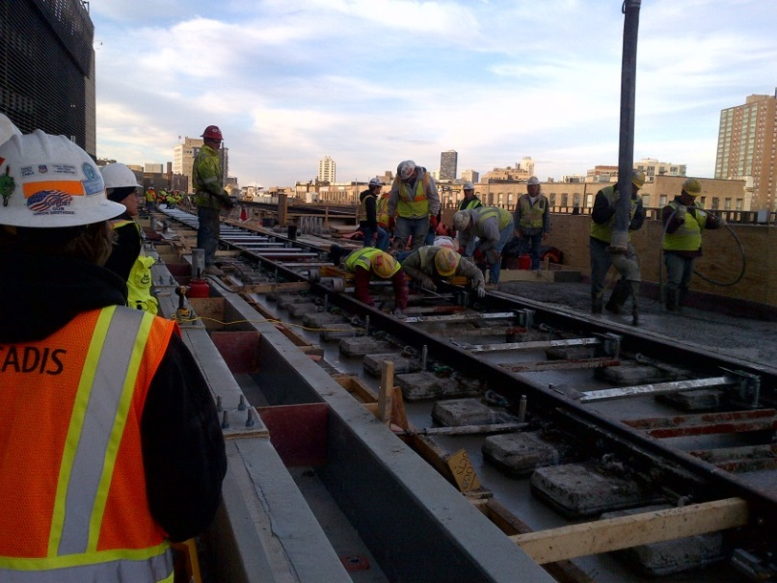
Appendix II
Factors affecting Rail Running Time
Slow Zones
Personnel on the Right-of-way
  Construction Activities
  Track Inspection
  Signal Maintenance
Ridership/Dwell Time
Loop/Terminal Congestion
Rail car Series
Car Length
Operator Experience
Operation Philosophy
Service Restoration Techniques

